Slide 1
COVID-19 – Effect on New York State Housing Market
Shobha Somashekar
Ben Sosa
Rey Sosa
Felix Hernandez

Slide 2
COVID-19 – Effect on New York State Housing Market Why?
We wanted to see what effects the Pandemic had on the Housing Market.
We hypothesized that people would want to move from areas with high numbers of COVID cases to areas with lower number of cases.
We focused on New York state.
We were able to demonstrate important changes in supply (New Listings), demand (Homes Sold), and price (Sale Price) that were temporally related to new COVID case counts. The changes shown support our hypothesis.

Slide 3
COVID-19 – Effect on New York State Housing Market Data Analysis Process
We used three data sources; USA FACTS (clinical cases), Redfin (housing market), and the US Census Bureau API (population).
Data was filtered to select: New York State counties and monthly data for the years 2018, 2019, and 2020.
Metrics used: number of new COVID cases, median new listings, homes sold, and median sale price.
Subsets of the data were created grouping NYC Metro, Suburbs (of NYC), NY State Rural counties.
Line plots by Metric for each Subset were created including all three years, where data available.

Slide 4

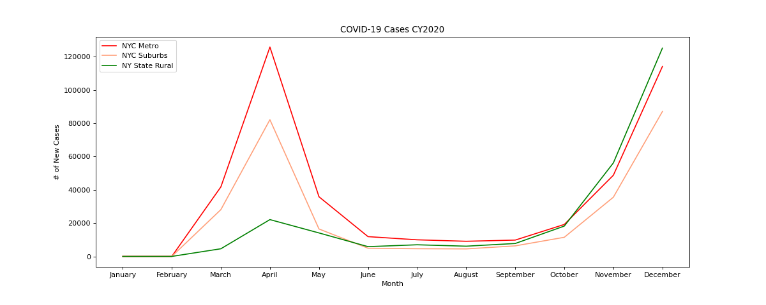
COVID-19 – Effect on New York State Housing Market

Slide 5
COVID-19 – Effect on New York State Housing Market Clinical Cases Summary
There was a sharp increase in COVID cases in the NY Metro and Suburb counties in March, April, and May.
The increase in the Rural counties was much less in March, April, and May.
There was a second sharp increase in cases in November and December – this time, all three groups had similar increases.
This suggests different underlying mechanism for the bimodal increases. Perhaps population density for the first and holiday travel for the second.

Slide 6
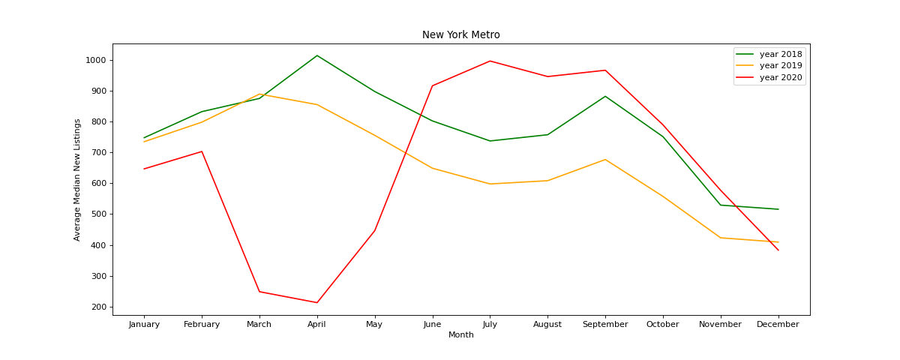
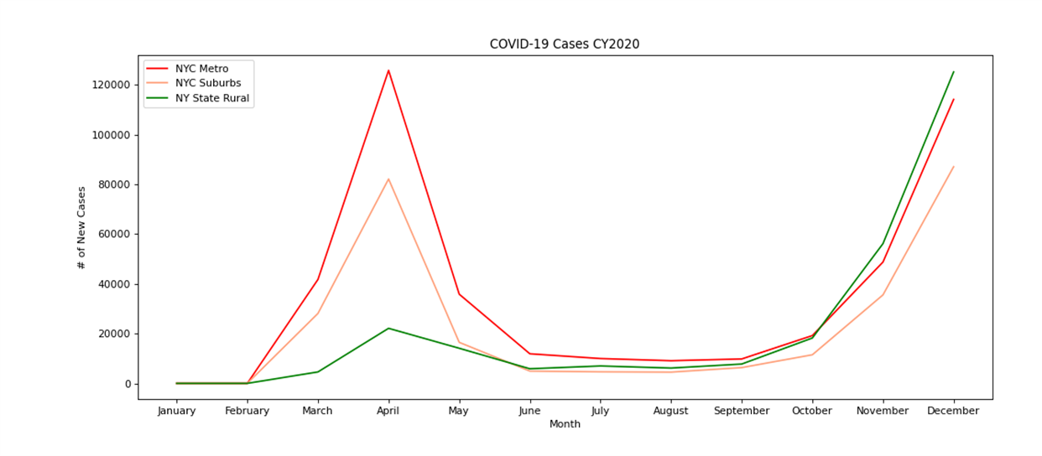
COVID-19 – Effect on New York State Housing Market New Listings – NYC Metro

Slide 7
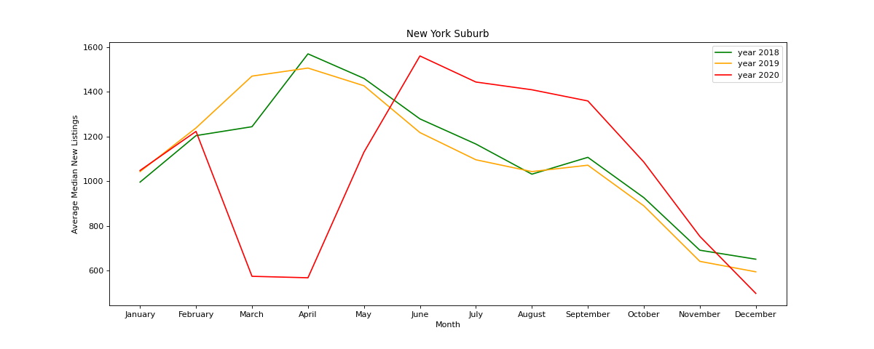
COVID-19 – Effect on New York State Housing Market New Listing - NYC Suburbs

Slide 8
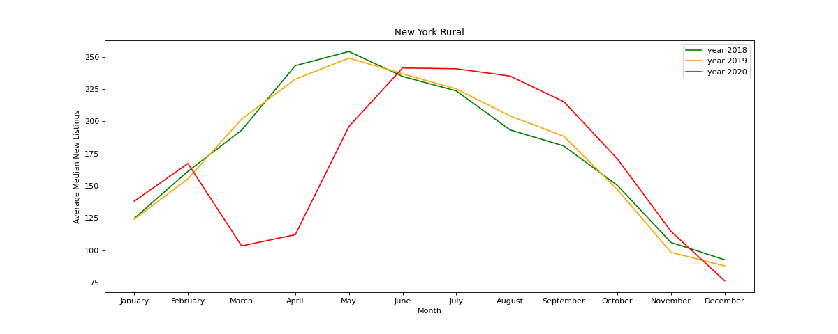
COVID-19 – Effect on New York State Housing Market New Listings - Rural NY State

Slide 9
COVID-19 – Effect on New York State Housing Market New Listings Summary
Housing Market Supply (New Listings) decreased in March, April, and May 2020 compared to 2018 and 2019.
Housing Market Supply then recovered and slightly exceeded previous years’ numbers from June through December.
This pattern was similar for all three county groups.

Slide 10
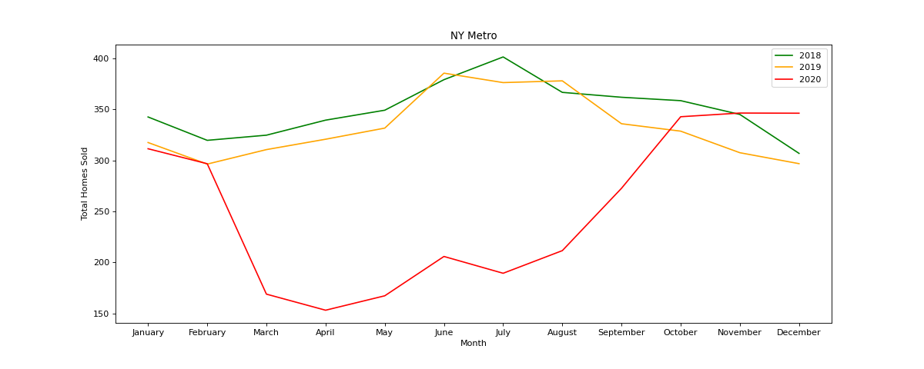
COVID-19 – Effect on New York State Housing Market Total Homes Sold – NYC Metro

Slide 11
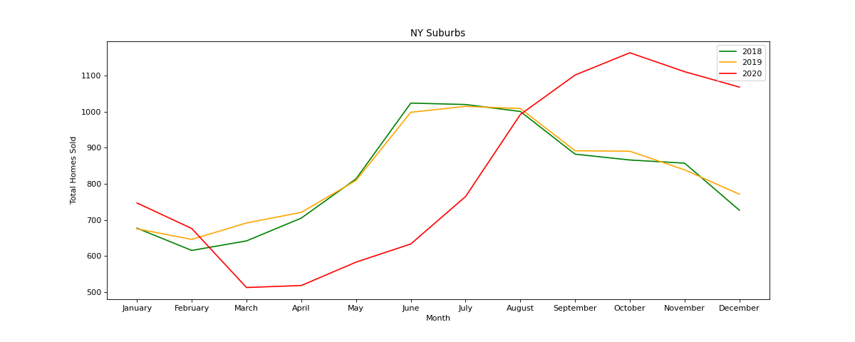
COVID-19 – Effect on New York State Housing Market Total Homes Sold - NYC Suburbs

Slide 12
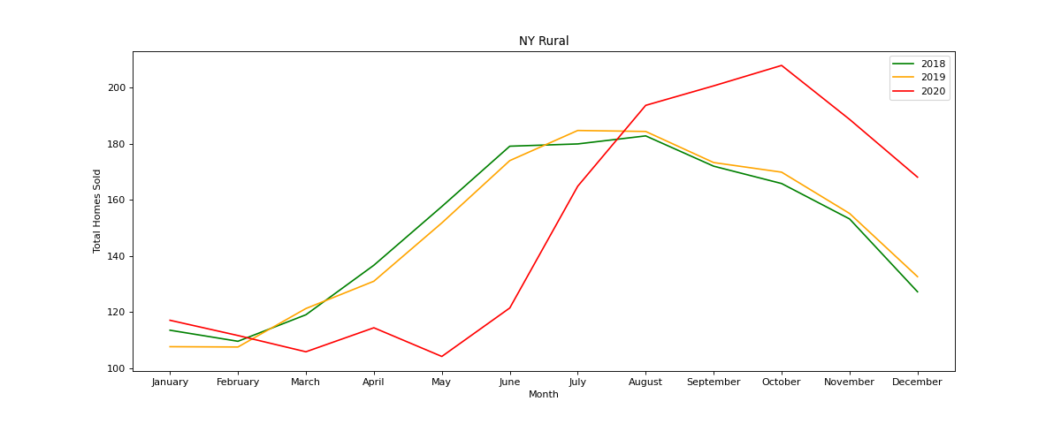
COVID-19 – Effect on New York State Housing Market Total Homes Sold - Rural NY State

Slide 13
COVID-19 – Effect on New York State Housing Market Total Sales Summary
Demand (Total Homes Sold) was decreased in the Suburb and Rural counties from March (2020) through June.
Demand in those two areas then exceeded 2018 & 2019 numbers for the remainder of 2020.
Demand in the NY Metro counties remained below that in previous years from March through September, only regaining the 2018 & 2019 curves in October of 2020.

Slide 14
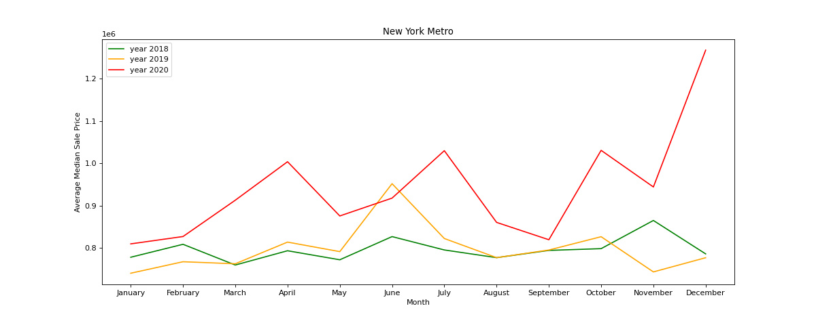
COVID-19 – Effect on New York State Housing Market Sale Price – NYC Metro

Slide 15
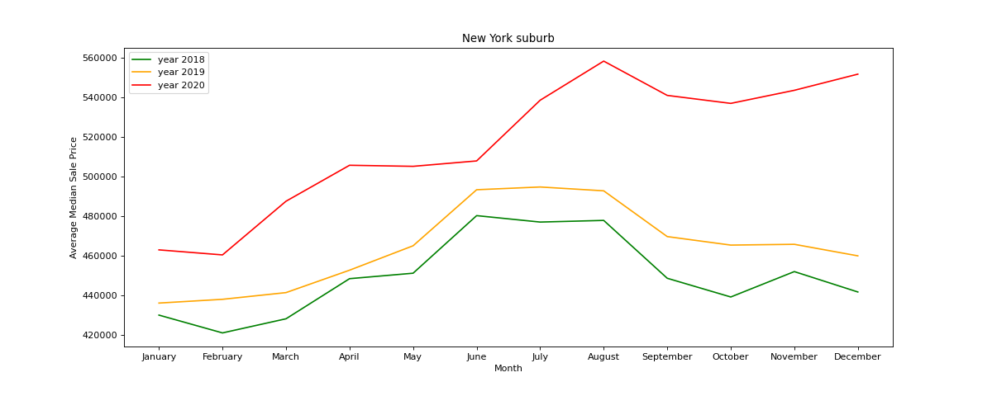
COVID-19 – Effect on New York State Housing Market Sale Price - NYC Suburbs

Slide 16
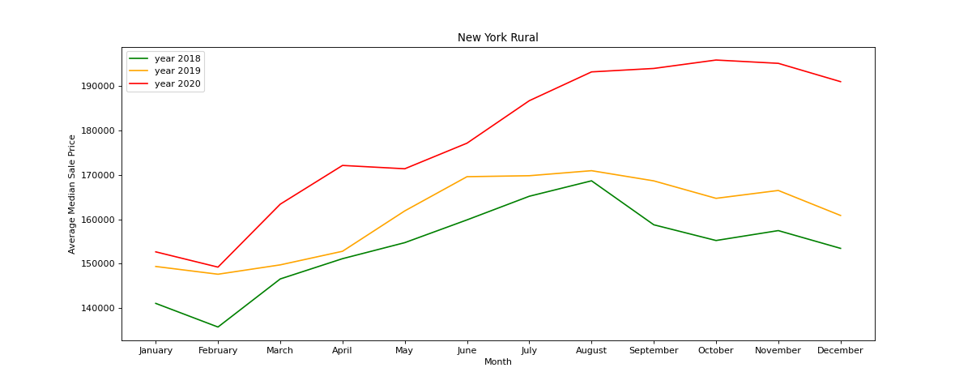
COVID-19 – Effect on New York State Housing Market Sale Price - Rural NY State

Slide 17
COVID-19 – Effect on New York State Housing Market Sales Price Summary
Median Sale Price was above that of previous years.
This was probably due to a relative supply shortage (fewer new listings than demand).
This was most clear in the Suburb and Rural counties where the demand was above previous years earlier in 2020 and less marked in the NY Metro counties where the demand took longer to recover.

Slide 18
COVID-19 – Effect on New York State Housing Market Postmortem
We only looked at housing market data for NY State and the New York City metropolitan area.
It is possible that people from the New York City Metro and Suburban counties purchased homes in other states such as Vermont, Pennsylvania, Maine, and others.
We did not look at other, smaller metropolitan areas in NY State such as Buffalo/Rochester.
We looked at only 4 metrics. One could add additional metrics such as Listing Price, % Sales Above Listing Price, and others.
Remaining question: What effect will the end of mortgage payment forbearance have on the future housing market?

Slide 19


